Slide 1
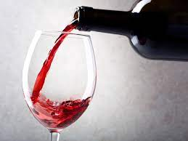
Predicting Wine Prices
Linear Regression & Web Scraping
-
Heather Swanke

Slide 2
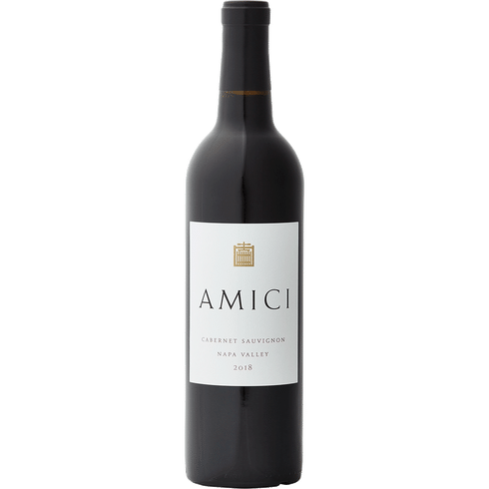
Introduction/Project Goal
What wine features have a strong correlation with price?
A local wine shop would like to ensure their prices are competitive with large scale online retailers.
Customers can benefit from this competitive analysis data as well!

Slide 3
Data Source and Methodology
https://www.totalwine.com/
Total Wine & More is an online/in-store retailer offers 3000+ red wines as part of their inventory
Python libraries used:
Selenium & Beautiful Soup
Sklearn
Seaborn
Pandas
595 rows of data (1 row per bottle of red wine)

Slide 4
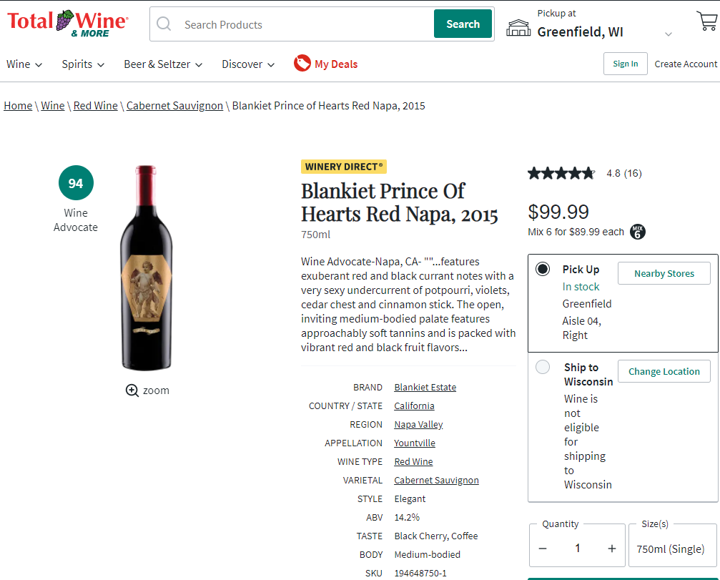
Variables
target variable: price
feature variables:
year
brand
country/state*
region
appellation
legally determined & protected wine regions
i.e. Champagne from France
varietal*
style
ABV
taste
body
Wine Advocate rating*
professional wine rating system established by Robert Parker, max score = 100
customer average rating
customer total ratings*
*no nulls in data set

Slide 5
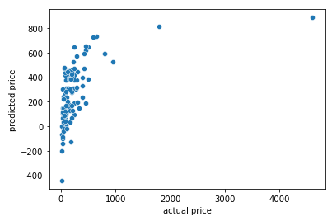
Final Model Performance
R^2 score on test data: .28
Features included:
Wine Advocate rating
ABV %
Body (full-bodied)
Country/State (6 dummy variables)
Highest volume values in data set: California, France, Italy
Varietal (9 dummy variables)
Highest volume values in data set: Cabernet Sauvignon, Bordeaux Blend, Rhone Blend

Slide 6
Conclusions
Wine Advocate Rating had the strongest correlation with price amongst all features + within variables included in final model
Year, customer total reviews, and customer average reviews all had very weak correlation with price
Location is correlated with price, not just international countries but domestic states too

Slide 7
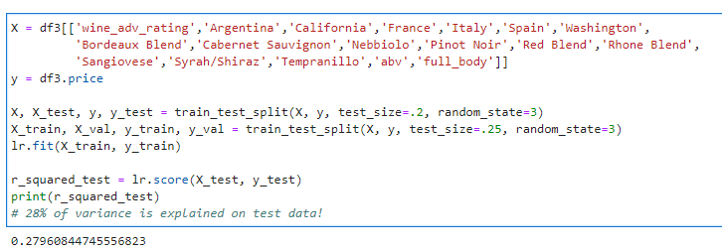
Appendix
Train/validation/test split: 60/20/20

